Slide 1
Advanced Data Analysis 367-2-5461
Opher Donchin

Slide 2
Things we know how to do that are hard for frequentists
Using prior information
For accurate predictions
For regularization
Robust estimation
Credible intervals
Change point analysis
Self-correcting workflow
Intuitive regression models

Slide 3
Topics
Homework
Types of model comparison
HDIs and ROPE
Bayes factors
Predictive power

Slide 4
Topics: BAP
Homework
Posterior predictive distribution (review)
Over and underfitting
In and out of sample accuracy
Cross validation vs information criteria
Entropy and KL divergence to justify information criteria
Log likelihood and deviance
AIC
WAIC
How is it computed?
LOO-CV
Pareto smoothed importance sampling
DIC and BIC
Arviz Compare function
WAIC and LOO warnings
Model averaging
Bayes factors
Marginal likelihood
Dependence on priors
Difficulty calculating
Combined models
Pseudo priors and reweighted priors
Sequential Monte Carlo
Bayes factors and information criteria
Too much data
Regularizing priors
Entropy
KL-Divergence

Slide 5
Topics BMCP
ELPD and deviance
LOO-CV
PSIS-LOO-CV
Arviz compare
ELPD per data point
Pareto shape parameter
What to do when k>0.7
How to interpret p_loo when k is large
LOO-PIT
LOO-corrected Bayesian p value
Model averaging

Slide 6
Topics SR 7
R^2
Overfitting
Underfitting and overfitting
Information theory for model target
Cost-benefit as a way of judging models
Model accuracy: joint probability
Log scoring rule
Information theory: reduction in uncertainty
Information entropy
Divergence
Increased entropy from using the wrong distribution
Difference of cross-entropy and entropy
Kullback-Leibler
Why is KL divergence asymmetric
Not knowing the target distribution
And how it cancels out
The score
Log pointwise predictive density
Deviance = -2*lppd

Slide 7
Topics SR 7 page 2
Training and test
Lppd on new data
In and out of sample deviance
Deviance for training and test
Improving prediction through regularization
Ridge regression
Predictive accuracy
Cross validation
No obvious optimum for # of folds
Divergence
Increased entropy from using the wrong distribution
Difference of cross-entropy and entropy
Kullback-Leibler
Why is KL divergence asymmetric
Not knowing the target distribution
And how it cancels out
The score
Log pointwise predictive density
Deviance = -2*lppd

Slide 8
Topics
R2
Overfitting and underfitting
Bias and variance
Building a measure
Scoring by highest joint probability
Distance by Kullback-Liebler divergence
Entropy -> Information -> Distance
Estimating the measure
Log pointwise predictive density: lppd -> ELPD

Slide 9
Topics
Training and test data
Regularizing prior
Cross validation
Leave one out
Importance sampling
Pareto smoothing of importance sampling
Information criteria
AIC
Penalty: number of parameters
WAIC
Penalty: effective number of parameters

Slide 10
Topics
Model comparison
Table
Score and difference, value and se
Warning
Pareto
WAIC influential
Weight
Plots
Comparison plot
Pointwise ELPD difference
Pointwise Pareto shape parameter
LOO-PIT

Slide 11
Topics
Model comparison and weighting
Bayes Factor
What is it?
Difficult to calculate
Sensitive to prior

Slide 12
Topics (restructured)
Why do model comparison?
Predictive accuracy
LOO-CV
WAIS
Diagnostics
Pareto parameter
Points with large variance in log posterior density
Understanding LOO-CV
The difference between in sample and out of sample posterior
Estimating out of sample posterior
Importance sampling
Pareto smoothing
Understanding WAIC
Correcting by estimating “peakiness”
AIC: using a normal approximation
WAIC: using the actual peakiness, measured by the variance

Slide 13
Topics
Homework
Types of model comparison
HDIs and ROPE
Bayes factors
Predictive power

Slide 14
Model selection and comparison
Why do model selection?
Different goals in model selection
Model selection or model averaging
Most likely model
Bayes factor
Reversible jump MCMC
Best predictive power
AIC, BIC, DIC, WAIC
Cross-validation

Slide 15
Why do model selection?
Hypothesis testing
Model complexity
Competing theories

Slide 16
Different goals in model selection
Parameter identification
Most likely model
Best predictor

Slide 17
ROPE and HDI

Slide 18
Parameter identification
Testing for a particular value
ROPE

Slide 19
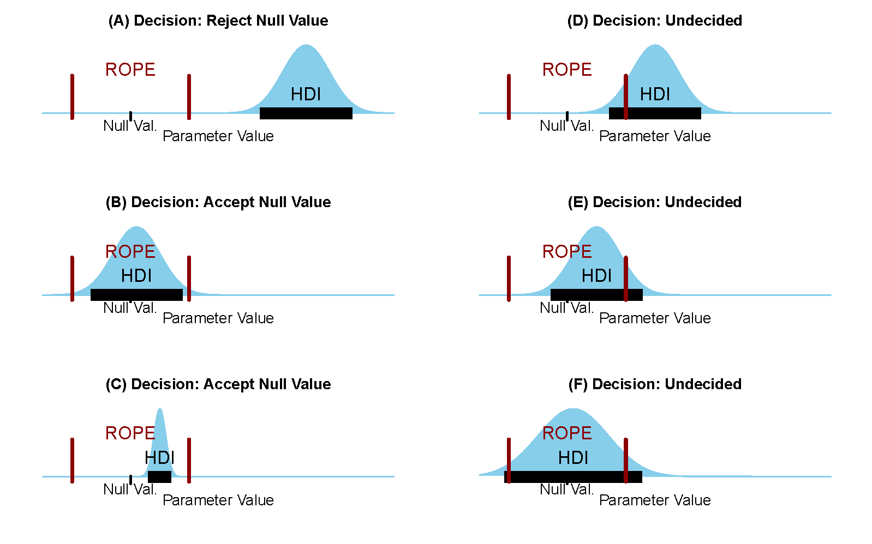
The ROPE and the HDI

Slide 20
Is this coin “fair”?
Set a ROPE: 0.49 to 0.51
If 95% HDI doesn’t overlap ROPE
Not fair
If 95% falls within ROPE
Fair
Otherwise
Hard to tell!

Slide 21
Topics
Homework
Types of model comparison
HDIs and ROPE
Bayes factors
Predictive power

Slide 22
The evidence
The evidence is the probability of the data (under the model)
Bayes’ Theorem:
Conditioning on the model:
The evidence:

Slide 23
Bayes factor
Comparing the probability of two models given the data
The evidence:
Bayes’ factor:
Posterior odds:
Posterior odds = Bayes’ factor x prior odds

Slide 24
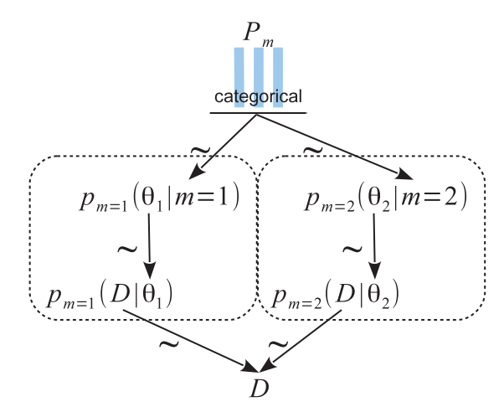

A Kruschke diagram for model selection
$P_{m}$ is the posterior probability of one of the models
Implicitly assume that $p\left(m_{1} | y\right)=1−p\left(m_{2} | y\right)$
Posterior odds:

Slide 25
Computing the evidence
Brute force: average likelihood over prior
Hard to do, numerically
Highly sensitive to prior
The evidence:
The marginal likelihood:

Slide 26
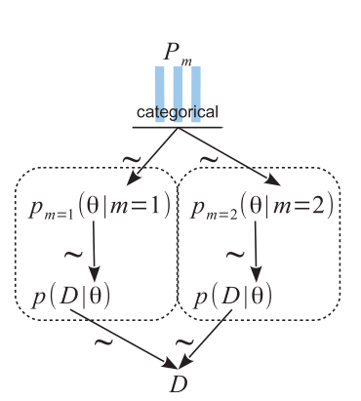
Implementing a hierarchical model
with pm.Model() as model_BF:
p = np.array([0.5, 0.5])
model_index = pm.Categorical('model_index', p=p)
m_0 = (4, 8)
m_1 = (8, 4)
m = pm.math.switch(pm.math.eq(model_index, 0), m_0, m_1)
# a priori
θ = pm.Beta('θ', m[0], m[1])
# likelihood
y = pm.Bernoulli('y', θ, observed=y_d)

Slide 27
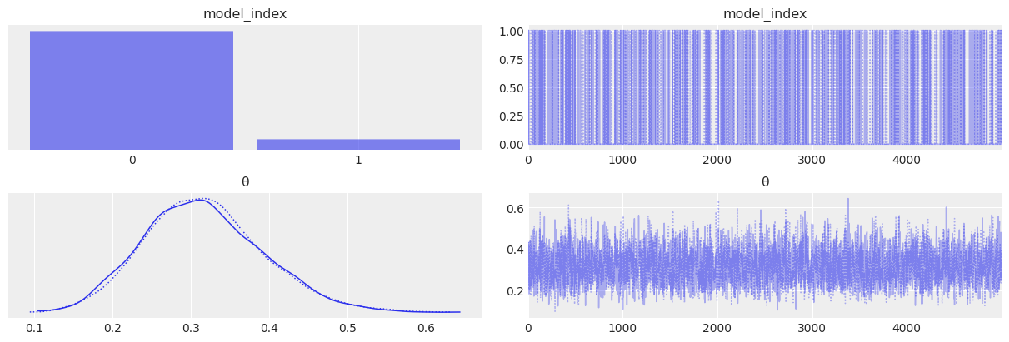
Running the model
pM1 = idata_BF.posterior['model_index'].mean()
pM0 = 1 - pM1
BF = (pM0 / pM1) * (p[1] / p[0])
f"{BF.item():.1f}"

Slide 28
Gelman on the Bayes factor
Bayes factors are sometimes used to make these model comparisons, but we find them generally to be irrelevant because they compute the relative probabilities of the models conditional on one of them being true.
We prefer approaches that measure the distance of the data to each of the approximate models.

Slide 29
Points about Bayes factors
Actually getting these models to run is hard
More pointers in BAP Chapter 5
More data -> larger Bayes factor
With enough data one model is always better
Bayes factor only meaningful if one model is the true model
Which is never true

Slide 30
Topics
Homework
Types of model comparison
HDIs and ROPE
Bayes factors
Predictive power

Slide 31
Predictive power
What is predictive power?
What are we trying to measure?
What

Slide 32
Model predictive power
Likelihood of “out-of-sample” data
Expected predictive density

Slide 33
Expected log predictive density
Usually use the log probability

Slide 34
Pointwise expected log predictive density (ELPD)
Usually use the log probability

Slide 35
Why the log predictive density?
Entropy:
The average log density

Slide 36
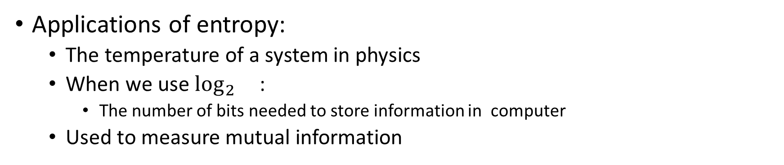
Why entropy?
Applications of entropy:
The temperature of a system in physics
When we use $\log_{2}{}$:
The number of bits needed to store information in computer
Used to measure mutual information

Slide 37
Measuring the distance of one probability from another
The Kullback-Leibler divergence
The “entropy” added by averaging over the wrong distribution
The cross entropy minus the entropy

Slide 38
In our case: the model from the truth
The distance of the model’s distribution from the true data distribution

Slide 39
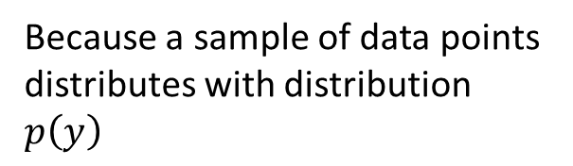
The score
Part of this we can estimate from data
Because a sample of data points distributes with distribution $p\left(y\right)$
The score

Slide 40
Calculating the score
Needs to be averaged over the posterior distribution under the model
Often people calculate deviance instead of score but it’s the same

Slide 41

The difference of two $D_{KL}$ for two models
Is the difference of their scores!

Slide 42
To compare models we want to calculate the score
Each score is meaningless, only the comparison matters
Easier to calculate than marginal likelihood
EXCEPT: we need new data
HOW CAN WE DO IT?
Fit to part of the data
Train / test
Cross validation
Use old data and calculate penalty
Information criteria

Slide 43
Direct estimation
“Reserve” some data and test after fitting model
Balance between
Variance in parameters
Variance in prediction
Easy to “taint” the out of sample data
Incompatible with idea of “model exploration”

Slide 44

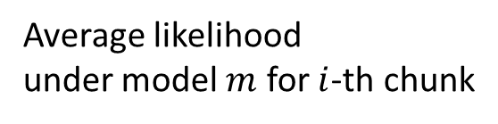
Cross validation
Posterior for $i$-th chunk
Split data into K chunks
For each chunk
Fit on all but that chunk
Test on that chunk
Average predictive ability across chunks
K-fold cross validation
Average likelihood under model $m$ for $i$-th chunk
Expected likelihood averaged over chunks

Slide 45
Cross validation
Advantages
Works well
Disadvantages
Requires K Bayesian fits
Requires lots of data
Balance between estimate variance and estimate of prediction

Slide 46

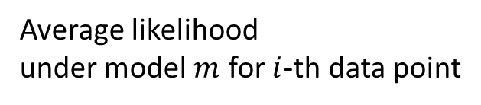
LOO Cross validation
Posterior for $i$-th data point
N-fold cross validation
Leave out only one data point
Can be estimated without refitting the model
But we don’t have samples from the “reduced” posterior
Average likelihood under model $m$ for $i$-th data point
Expected likelihood averaged over points

Slide 47
LOO integral trick
We wish we had samples from the “reduced” posterior
Without 1 data point
The LOO posterior probability
Predictive density of point $i$ for posterior without point $i$

Slide 48
LOO integral trick
This means we are integrating over the full posterior, so we can use samples from the full posterior
We want to sample the full posterior
This is the “importance ratio”: the ratio between what we want to sample and what did sample

Slide 49
Importance sampling
Instead of integrating of a hard distribution
Sample an easy distribution
Average over the samples
BUT weight each sample by the ratio of the two distributions

Slide 50
What is that ratio?

Slide 51
LOO-IS
Leave one out with importance sampling
The LOO posterior probability
Importance sampling estimate of LOO posterior predictive
The LOO posterior predictive probability
The average LOO posterior predictive probability
The average LOO posterior predictive probability

Slide 52
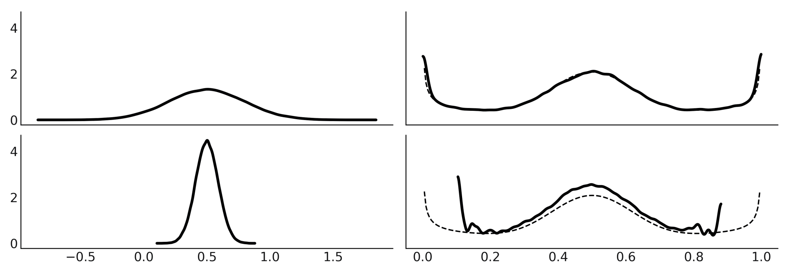
Importance sampling with a thick tailed proposal
Which has thicker tails?
The full posterior or the reduced posterior

Slide 53
PSIS LOO CV
Pareto smoothed importance sampling
Leave one out
Cross validation
Fit Pareto distribution to the weights of the heaviest weighted points.
Usually 10-20% of the data points
Replace weights of lower weighted points with Pareto quantile

Slide 54
Information criteria

Slide 55
Information criteria
Predict average distance of new data
Akaike Information Criterion (AIC)
Bayesian Information Criterion (BIC)
Deviance Information Criterion (DIC)
Watanabe Akaike Information Criterion / Widely Applicable Information Criterion (WAIC)

Slide 56
All information criteria
In sample log likelihood
Predictive out of sample penalty
More generally:

Slide 57
Akaike Information Criterion (AIC)
Assume normal distribution of parameters
At least at peak
Assume ML estimate
Distance of model from data is:
Distance of model from existing data
Distance of true model from ML model
Depends on dimensions

Slide 58
Bayesian Information Criterion (BIC)
Estimate of Bayes factor
Without calculating prior or evidence
More appropriate to first half of talk
Greater penalty for number of parameters

Slide 59
Deviance Information Criterion (DIC)
Extension of AIC
Bayesian approach
Works for
Non-normal posteriors
Hierarchical models and correlated parameters
Uses samples from the posterior for computation

Slide 60
Advantages and disadvantages of DIC
Advantages
Widely used
Can be calculated easily from the MCMC samples
Calculated by BUGS and JAGS
Handles hierarchical models
Disadvantages
Poor theoretical foundation (uses point estimate)
Can not handle discrete variables or mixture models
Affected by parameterization
High variability for skewed distributions of the parameter

Slide 61
Widely Applicable Information Criterion (WAIC)
Calculated in Stan
Improves on the DIC by calculating DIC for each point and then averaging
Closely approximates LOO Cross validation

